Slide 1

Module 10 – SMA-X Reports and Dashboards
Jan 2018
Notes:
[STANDARD SLIDE: L300 (animated)]
You can change out the photo with any image from Getty Images in DropBox.
If the main title is shorter, you can make the font larger.
You may have to move the title text around depending on the photo. Make sure the text is readable against the background photo.
You can change the background color for the rectangle in the bottom-right corner to look better against the background. Choose a Micro Focus color at 25% transparency.
=========================
Note to Narrator or Reader: [PRESS] indicates press the Page Down key to show the animation
=========================
Hello and Welcome to the [COURSE_NAME] Technical Overview Training, Level 300.
In this course you’ll gain a high-level understanding of the essentials of [PRODUCT_NAME].
[PRESS] If you want to download this presentation and save it on your own system, click the Tools & Help icon in the bottom-right corner of your window and select Download.
Or, if you want to access the PPT slides and speaker notes for future reference, go to the Attachments tab in your window click to download the presentation.

Slide 2
Objectives
After completing this module, you should be able to:
Describe Reports and Dashboards features
Navigate the Reports and Dashboards User Interface
Create new Reports
Add new reports to your Dashboard
Understand the difference between Operational and Analytic report types

Slide 3
Overview

Slide 4
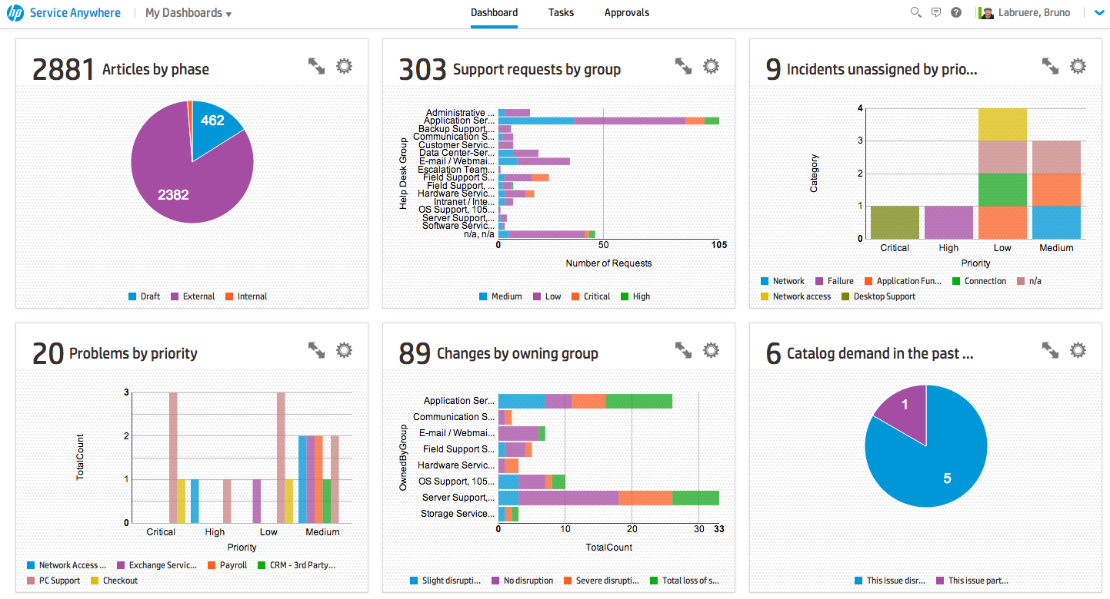
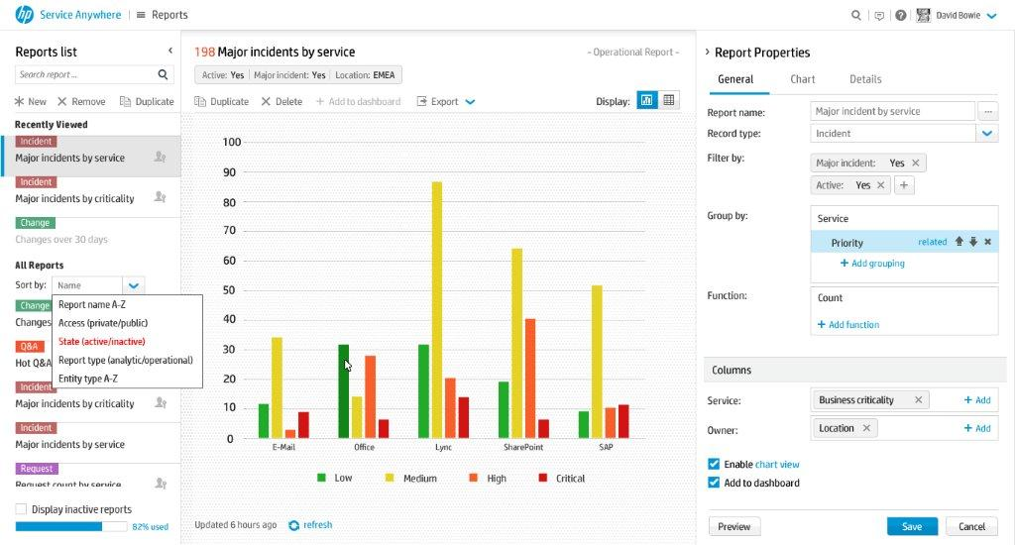
Reporting and Dashboard Overview
More than 100 reports provided
Reporting
Easily create operational or analytical reports
Shared or private
Multiple levels of grouping, stacked/grouped bar charts, line charts for trend reports
Support multiple functions (sum, count, average)
Group date by period (year, month, day…), Group by and filter by related entity fields
Dashboard
Can be the landing page or accessed easily through main menu
Drag & Drop to rearrange reports order
Easily configure report size
Responsive web design
Notes:
More than 100 reports out of the box in the existing version and more coming in every new version

Slide 5
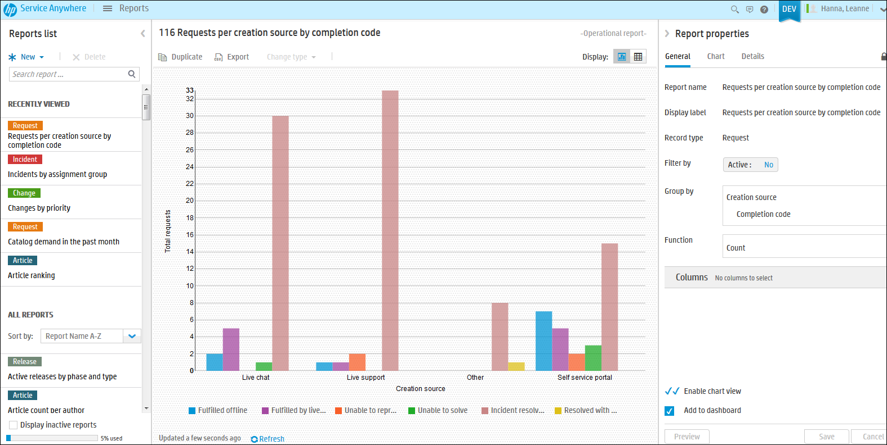
Flexible Reporting Framework
State of the art reporting and analytics
Intuitive User Experience.
Group by and filter by related entity fields and to many levels.
Reports can be saved publicly or private depending on permissions.
Sliced drilldown from chart to operation grids.
Fast performance.
Notes:
Reports enable you to view the current status of the system. You can view out-of-the-box reports or create your own reports based on record type. The data can be grouped or filtered to display the specific information and data as relevant to your work. Reports can be saved publicly if you have appropriate permissions, or for your private use. Reports can be viewed in the Reports module or in your Dashboard.

Slide 6
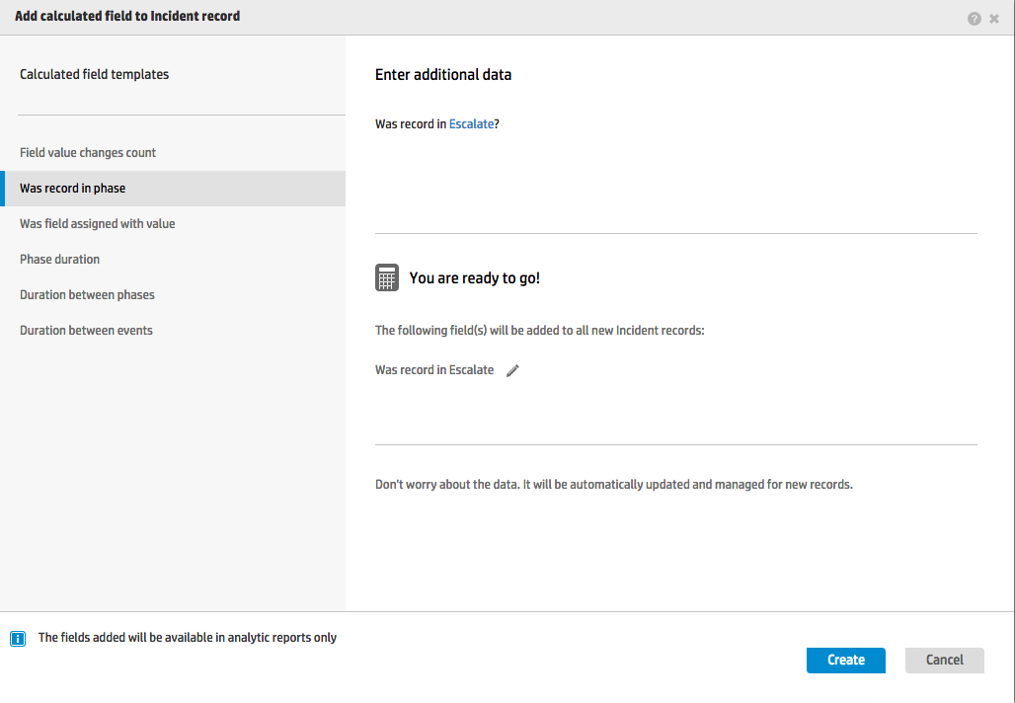
Metric Based Reporting
Add new calculated fields to a record
Values based on calculation can be used in analytical reports
The following calculation templates are provided
Number of times a field was changed (e.g. count the number of reassignments)
Was in phase (e.g. was incident escalated?)
Was a field set to specific value (e.g. was assigned to XXX group?)
Duration of phase (e.g. duration of classify phase)
Duration between enter phase 1 to leave phase 2 (e.g. duration between entering log phase to exit execute phase)
Notes:
Calculated field are only used in analytic reports, not operational reports.
Of particular interest with the calculated fields is the ability to produce duration type reports:
for example how long was a record in the classify phase
or even how long did it take from entering the classify phase till it exited the fist level support phase
Another capability of calculated fields allows you to produce reports that count field level changes
for example how many times was record re-assigned to different help desk groups
So two steps to the process
Add field to record
Then Create an analytics report using the field

Slide 7
Reporting
Reports are organized according to four categories
Operational report | Analytic report
Reports that reflect real-time data for a record type Generated on the fly Limited to xx,000* lines of raw data Cannot be grouped by time field properties Can be generated by all users Reflects the data domains of the user viewing the report Calculated fields not available Aggregated data limited* | Reports that reflect historic data for a record type over time Calculated according to a defined schedule No limit to the raw data Can be grouped by time field properties Can use calculated fields Can be set as active or inactive; the active reports are counted toward the quota* defined for the tenant Reflects the data domains of the user that created the report COMPLEX_TYPE, IMAGE, LARGE_TEXT, and RICH_TEXT field types not available Aggregated data limited*
Operational raw data report | Survey analytic report
Operational reports without groupings or functions Only the grid report is available | Analytic reports that are based on a survey record Used to display results of a survey
*See the online help for current report specifications.
Notes:
The quota usage is based on the number of active analytic and survey reports as well as the recalculation frequency of those reports
The quota is equivalent to 1000 reports running daily. If you change the frequency (increase/decrease), you apply the relevant multiplication factor (for example 1000/24 if you change all frequencies to hourly).

Slide 8
System settings in the 2017.11 release
See online help for system settings in the current release
Item | Description | Previous value | New value* | Default
EMS query | # records returned in query (e.g., list of records) | 4k | 4K -- 100K | 10K
Report quota | Quota per scheduled analytic report 1 credit per annual report [meaning 12 credits to run monthly, 365 credits to run daily] | SaaS 365k credits [=1000 daily] | 1M-3.6M credits [=3K-10k daily] | 1M
Mass update | # records to edit at same time through the mass update UI | 250 | 250 -- 2K | 500
Business Rule links | # related records that can be updated via a business rule | 250 | 250 -- 1K | 500
Approval | # approval tasks created by approval engine | No limit | 250 -- 1K | 500
* MSPs may control in similar fashion
Notes:
See email Comprehensive list of limit changes in X (vs SAW
BR - we have BR template accessing data through links, either 1-2-many or m2m. There is a fuse to control that how many links it can access. If there is no control, than very likely any wrong data will burn the workflow engine. Any feature using this, directly or indirect, will controlled by this. The group email notification is implemented through WF, thus the BR link# controls how many people in a group can receive emails. But it controls more, depends on how BR templates are using
Approval – if assignees for multiple person, or group(s) with multiple person, approval engine with create 1 approval task per people. On SAW there is no control, so if assigned group contains 2000 people, there will be 2000 approval tasks created, useless (it’s not president selection), and risk of overflow system. Now we added the control at only 500 approval can be created.
DO WE WARN USER TOO MANY APPROVALS?

Slide 9
Reports User Interface

Slide 10
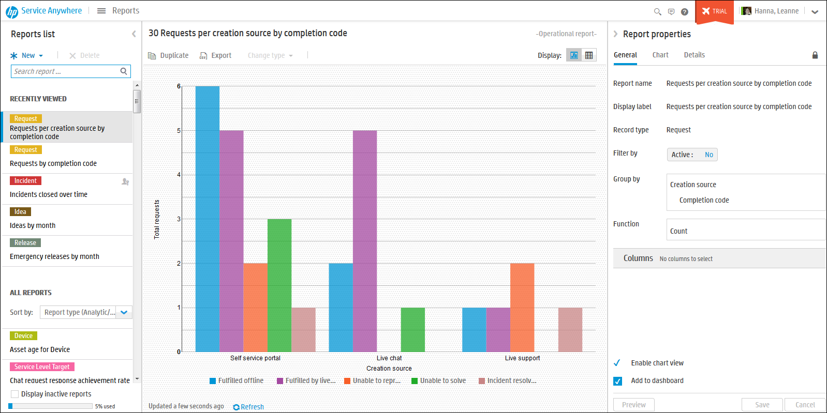
Reports List Pane
Reports Center Pane
Shows type of report
Locked report
Add new report
Switch between tabular view and chart view
Recently Viewed
Reports Properties
All Reports
Notes:
Reports List Pane
The Reports center pane displays the report selected in the Reports list.
The following options are available:
Duplicate – Click Duplicate to create a new report based on an existing one. You can make changes to the new report in the New report dialog box. Both the original report and the new one are saved.
Export – Click Export to export the grid report to a CSV file.
Change type – Click Change type to change the type of a report. The original report is not saved. Note: This option is not relevant for survey reports.
Activate/Deactivate – For analytic or survey reports, click Activate or Deactivate. Active reports are counted toward the quota; inactive reports are not counted.
Display – Select the option for displaying the report (Chart views as a chart, Grid views as a table).
Refresh – Click Refresh to refresh the report.
For further information, please refer to the Help Center.

Slide 11
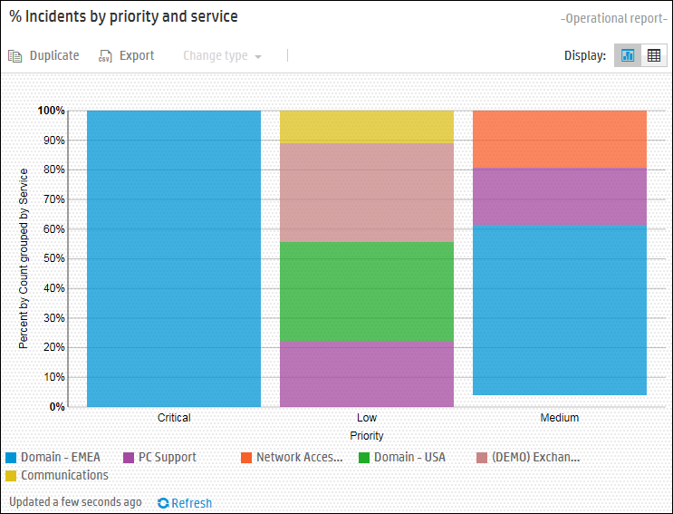
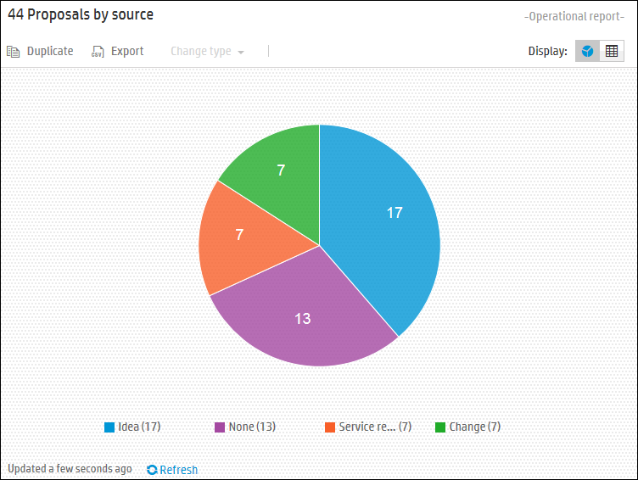
Report Types – Operational
Operational reports reflect real-time data and are generated on the fly.
They are useful for a limited amount of data (see online help for current limit).
Notes:
Operational Reports
Reports that reflect real-time data for a record type
Generated on the fly
Limited to 4,000 lines of raw data
Cannot be grouped by time field properties
Can be generated by all users
Reports troubleshooting and limitations
Please see Help Center > Reports > Reports troubleshooting and limitations

Slide 12
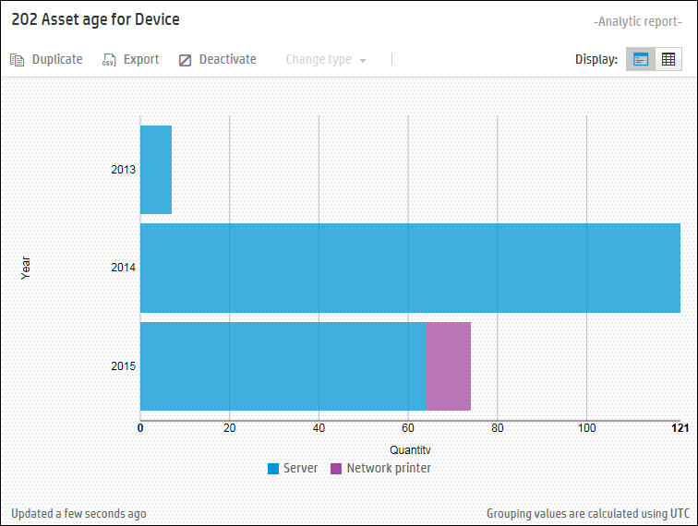
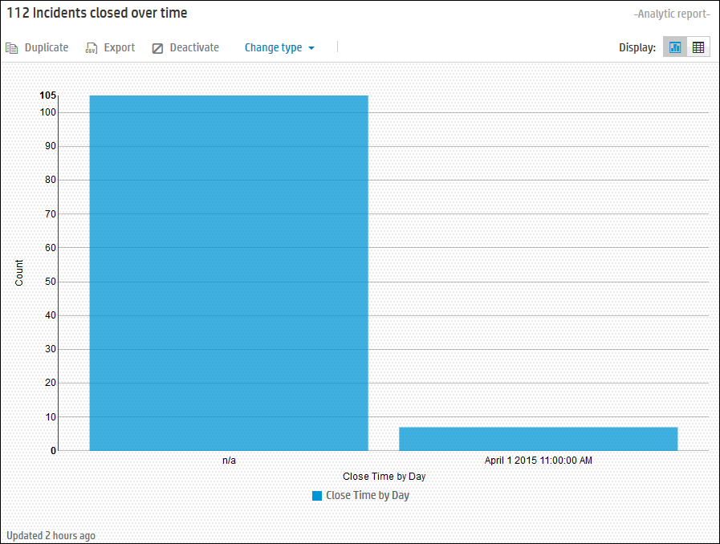
Report Types – Analytic
Analytic reports reflect historic data for a record type over time.
Can be generated for an unlimited amount of data and to a defined schedule.
Notes:
Analytic Reports:
Reports that reflect historic data for a record type over time
Calculated according to a defined schedule
No limit to the raw data
Can be grouped by time field properties
Can be generated by Admin users only (a user with the Reports publisher role)
Can be set as active or inactive; the active reports are counted toward the quota defined for the tenant
Reports troubleshooting and limitations
Please see Help Center > Reports > Reports troubleshooting and limitations

Slide 13
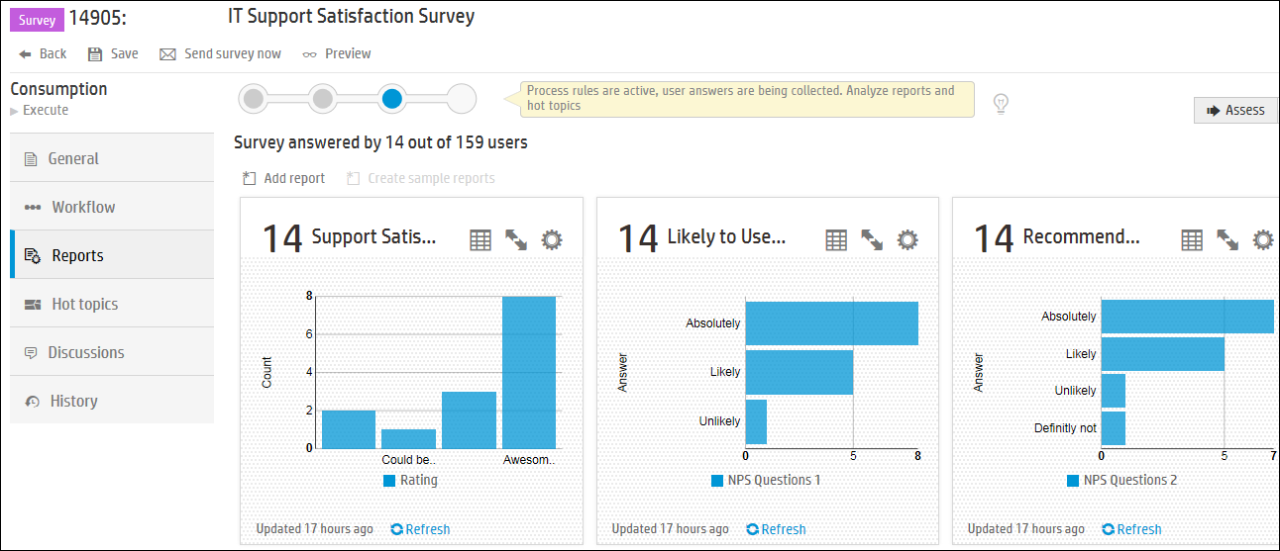
Report Types – Survey
Survey reports are analytical reports based on the results of a survey.
Notes:
Survey Reports:
Analytic reports that are based on a survey record
Used to display results of a survey
Reports troubleshooting and limitations
Please see Help Center > Reports > Reports troubleshooting and limitations

Slide 14
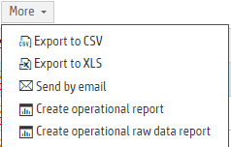
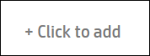
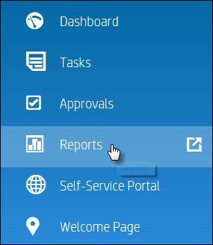
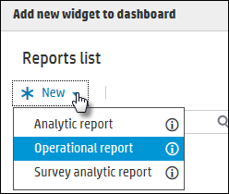
Add a new Report
Report Creation
All options use the same wizard
From a list of records
From your dashboard
From the Reports menu

Slide 15
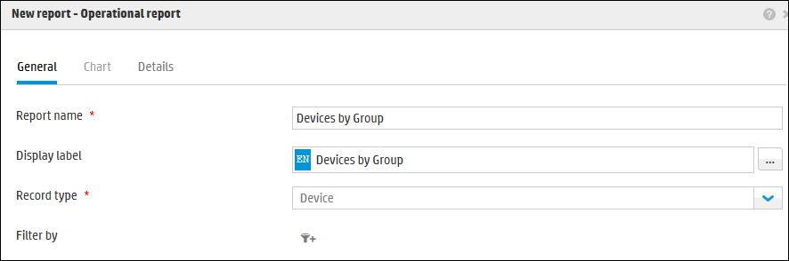
Add a new Operational Report (1)
Click New and select Operational report
Type Report name, Display label and Record type.
Can translate into different languages

Slide 16
Add a new Operational Report (2)
Add a Filter by if you wish to search for particular records.

Slide 17
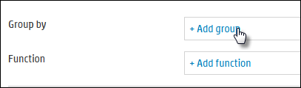
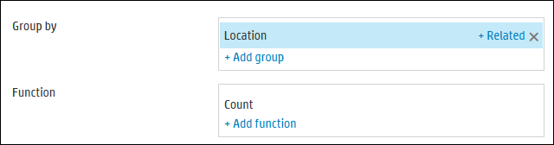
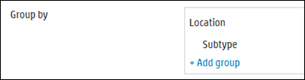
Add a new Operational Report (4)
Select Group by which can group to multiple levels and related record properties.
Grouping can go to multiple levels

Slide 18
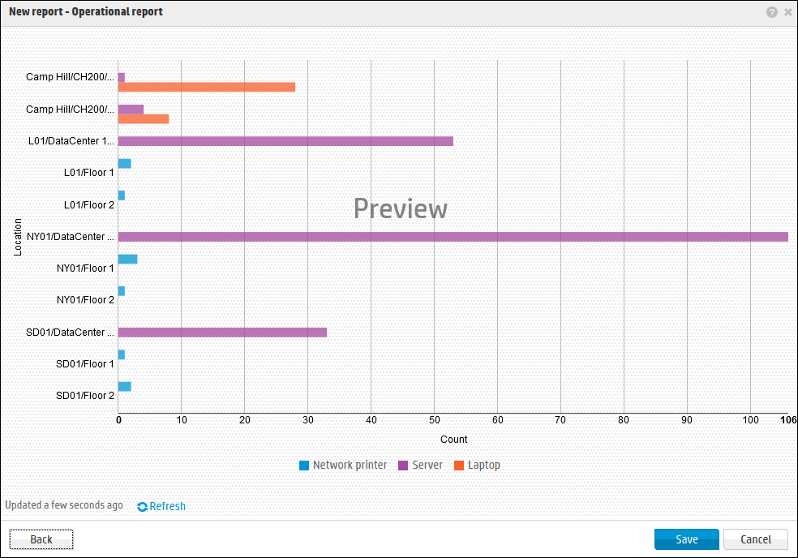
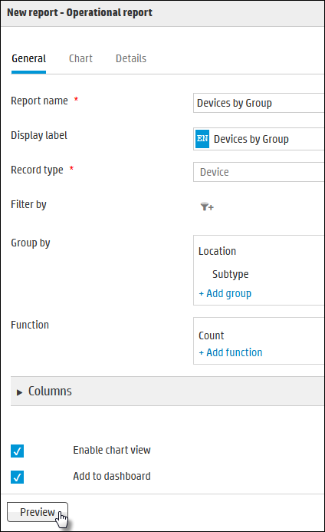
Add a new Operational Report (5)
Click Preview.

Slide 19
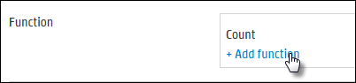
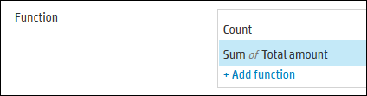
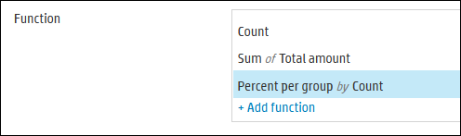
Add a new Operational Report (6)
A basic report does not need to use grouping or functions
Select Function if further slicing and dicing is required for the report.
Functions can go to multiple levels
Notes:
Report advanced options
You can create reports based on groupings and functions, or a more basic report on a record type without groupings or functions (Operational raw data report).
Note: You cannot select a grouping without a function or a function without a grouping.

Slide 20
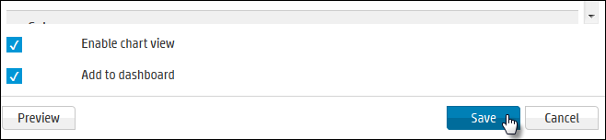
Add a new Report (7)
Click Save to save report.
Add new report to your dashboard

Slide 21
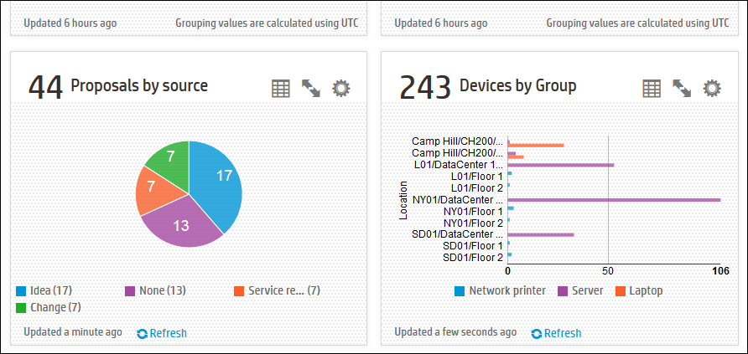
Add a new Operational Report (8)
The report will be displayed in your Dashboard.

Slide 22
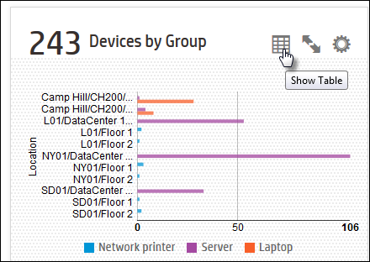
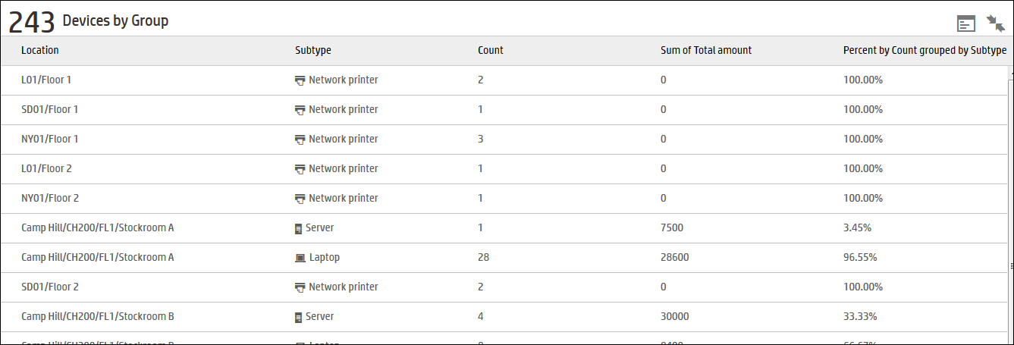
Show Table from Report
To view in table view, click Show Table or maximize the report to Show Table.
Shows Count, then Sum of Total amount, then % by Subtype
Shows Count, then Sum of Total amount, then % by Subtype
Shows Count, then Sum of Total amount, then % by Subtype
Group by Location and then by Subtype
Group by Location and then by Subtype

Slide 23
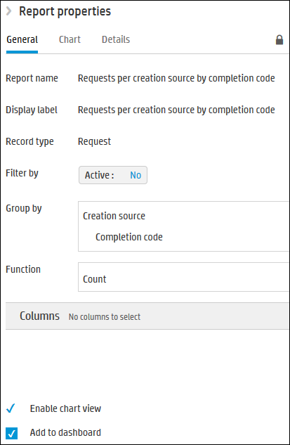
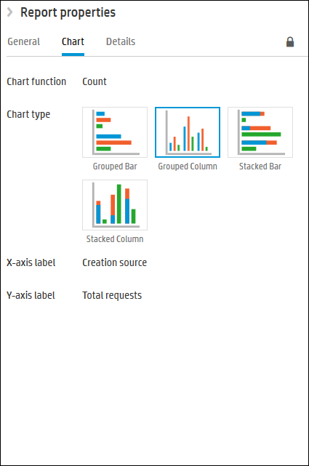
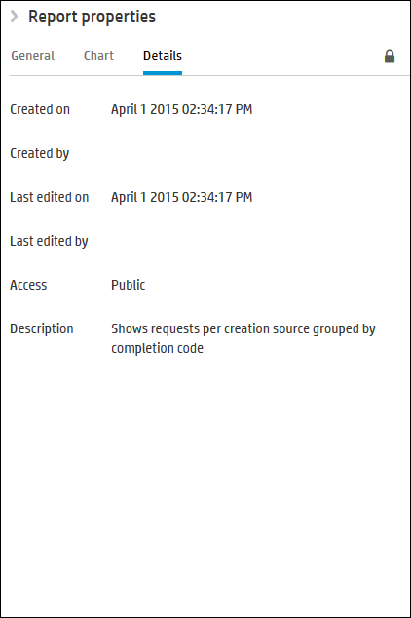
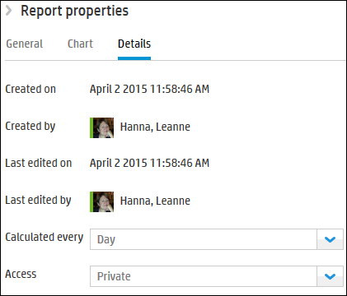
Report Properties
Details of Operational report details tab
Defines the properties of the selected report.
Details of Analytic report details tab
Schedule for Analytic report
Permissions for who can see the report
Notes:
Report Properties
The Report properties pane, located on the right, defines the properties of the selected report. Data in reports can be filtered and grouped by the attributes of the record on which the report is based.
The following tabs are available both for defining a new report in the New report dialog box and for editing an existing report in the Report properties pane.
General tab
Chart tab
Details tab
Note: Locked reports (indicated by a lock icon in the Report properties pane) cannot be edited. Out-of-the-box reports are locked, but analytic out-of-the-box reports can be activated or deactivated.

Slide 24
Dashboard User Interface

Slide 25
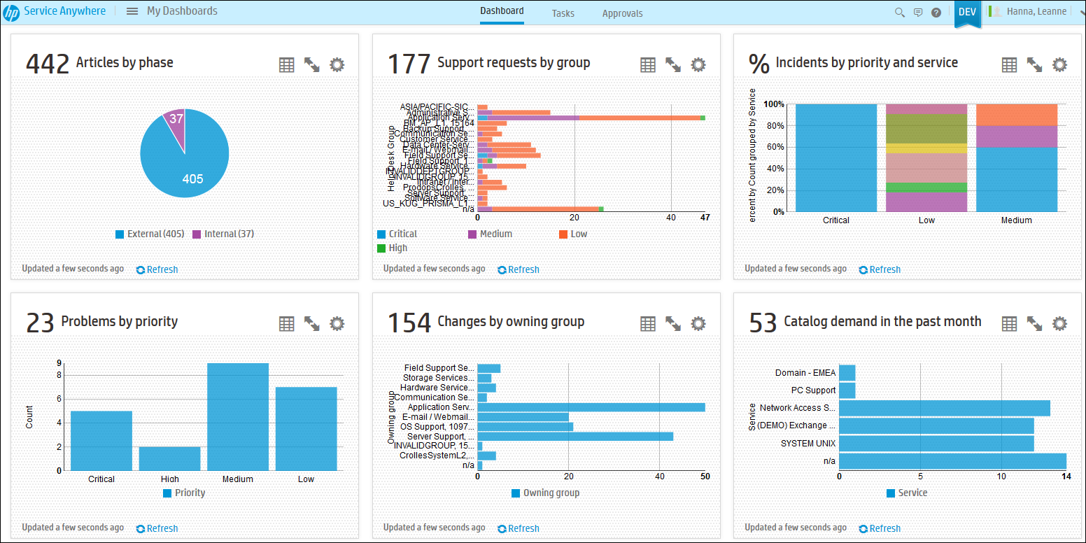
Dashboard
Mega Menu > Dashboard
Your Dashboard is your Landing Page, enabling you to view multiple reports.
Last update time
Refresh if operational report
Notes:
How to work with reports
You can create reports and view them as tables or charts. Charts can be viewed as columns, pies, or bars. Each of these options can be selected and viewed dynamically by any user who has access to the report. Reports viewed in the dashboard can also be changed dynamically.

Slide 26
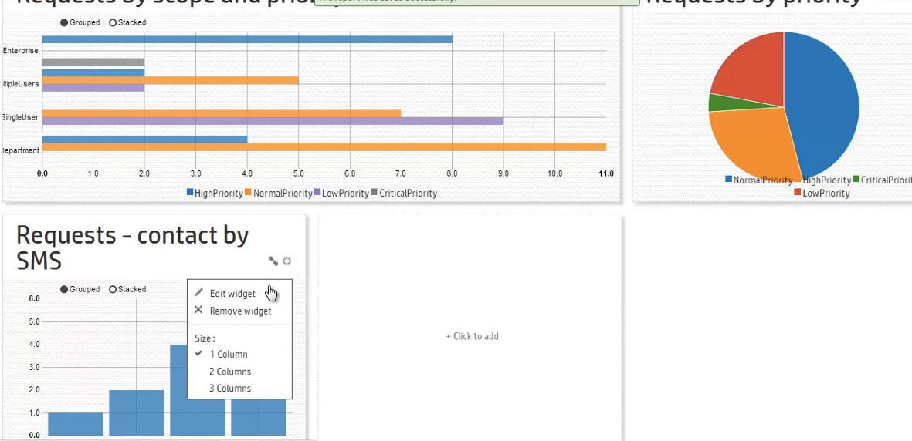
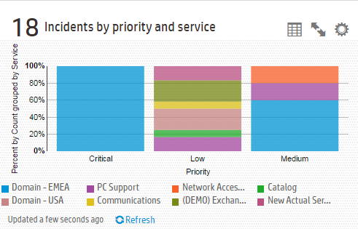

Dashboard Personalization
You choose the size of the report
Dashboard supports drag & drop rearrangement
Reports can be displayed as a chart or table
Each user has their own dashboard

Slide 27
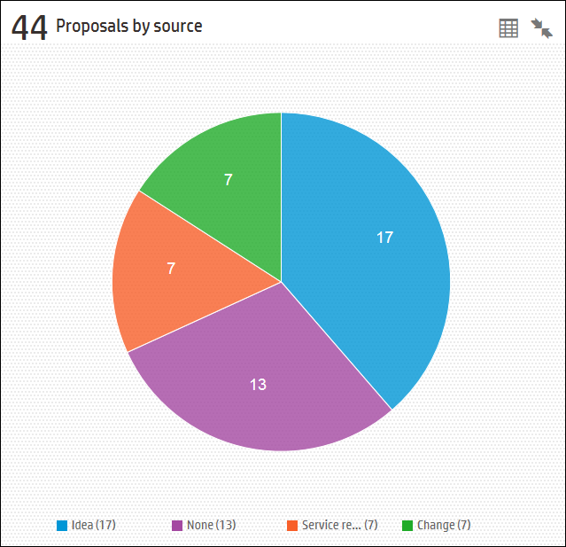
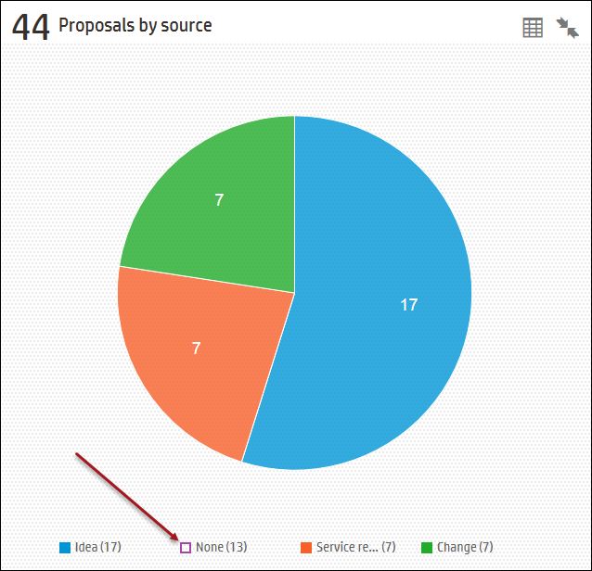
Interact with Report on the fly
De-select an input to update report on the fly

Slide 28
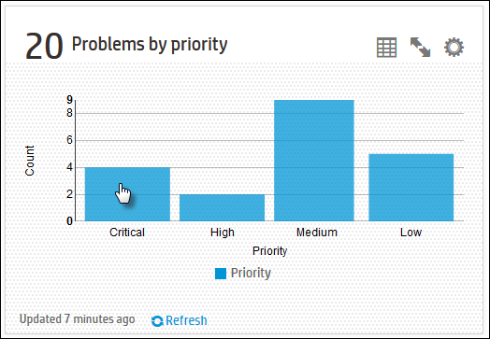
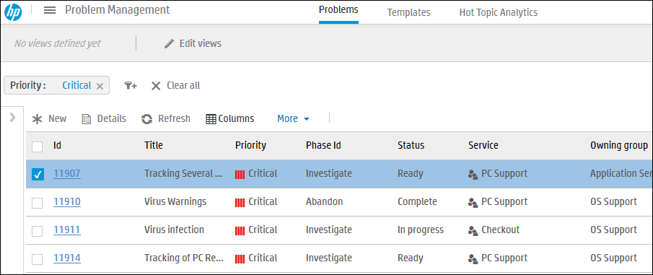
Drill into the data within the report
Click on a segment to show records in Record List.
Notes:
Drill down capability:
In a chart report, click a bar or a pie slice to drill down to the source data in the relevant module. In a stacked or grouped report, the drill down goes to the source data of the specific subgroup selected.
In a grid report, hover over a row of the grid and click the drill down icon at the left to drill down to the source data in the relevant module.
Note:
This option is not relevant for survey reports.
At least one of the fields selected for the report filter or the grouping options must be a searchable field. Searchable fields are defined in the metadata for the record type.
If the source data for the selected bar or slice of a chart or grid row is greater than 4,000 rows of data, you cannot drill down to it.
Drill down is not available for reports based on articles, models, or Service Level targets.
In an analytic report, if the report is grouped by a time field by hour, you cannot drill down to the source data.
In an analytic report, if the report is grouped by a time field, you cannot drill down to the source data for the section representing a null value.
For further information, please refer to the Help Center.

Slide 29


Lab Exercises
Reporting and Hot Topic Analytics Quick Flow Demo Card

